Slide 1


Course: CCS3104 Project
CCS3104-Group Project
IKEA AR Interior Design Assistant
With Community-based Design Reuse
Focus: Integrating AR, AI, and Community
Group Member
YUE CHENGHAO | 227154
HUA JIE | 226758
WANG KAILUN | 227046
"Transforming furniture shopping from a static catalog into an interactive, intelligent, and socially supported design process."

Slide 2

Company Overview: IKEA’s Legacy and Digital Evolution
Founding & Philosophy
Founded in 1943 by Ingvar Kamprad; built on "Democratic Design" balancing Form, Function, Quality, Sustainability, and Low Price.
Core Innovation
Pioneered flat-pack furniture in the 1950s, revolutionizing affordability and global logistics by reducing transportation costs.
Global Reach & Digital Strategy
Operates in 60+ markets. Currently investing heavily in e-commerce, smart home solutions, and mobile apps to integrate technology with daily living.

Slide 3

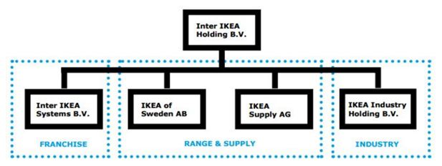
Organizational Structure: Strategic Project Alignment
Inter IKEA Group
Ingka Group
Key Departments
Brand Ownership
Retail Operations
Digital Innovation & IT
Oversees the IKEA concept and global brand
Manages physical stores and customer
Lead development of AR and AI modules.
identity.
touchpoints.
Marketing & CX
Product Development
Digital Services
Drive user adoption and community
Provides core furniture data and design
Primary host for the AR Assistant's deployment
engagement.
direction.
and user interface.
Strategic Integration
The AR Assistant bridges the gap between product design (Inter IKEA) and retail experience (Ingka), ensuring a seamless digital-to-physical customer journey.

Slide 4
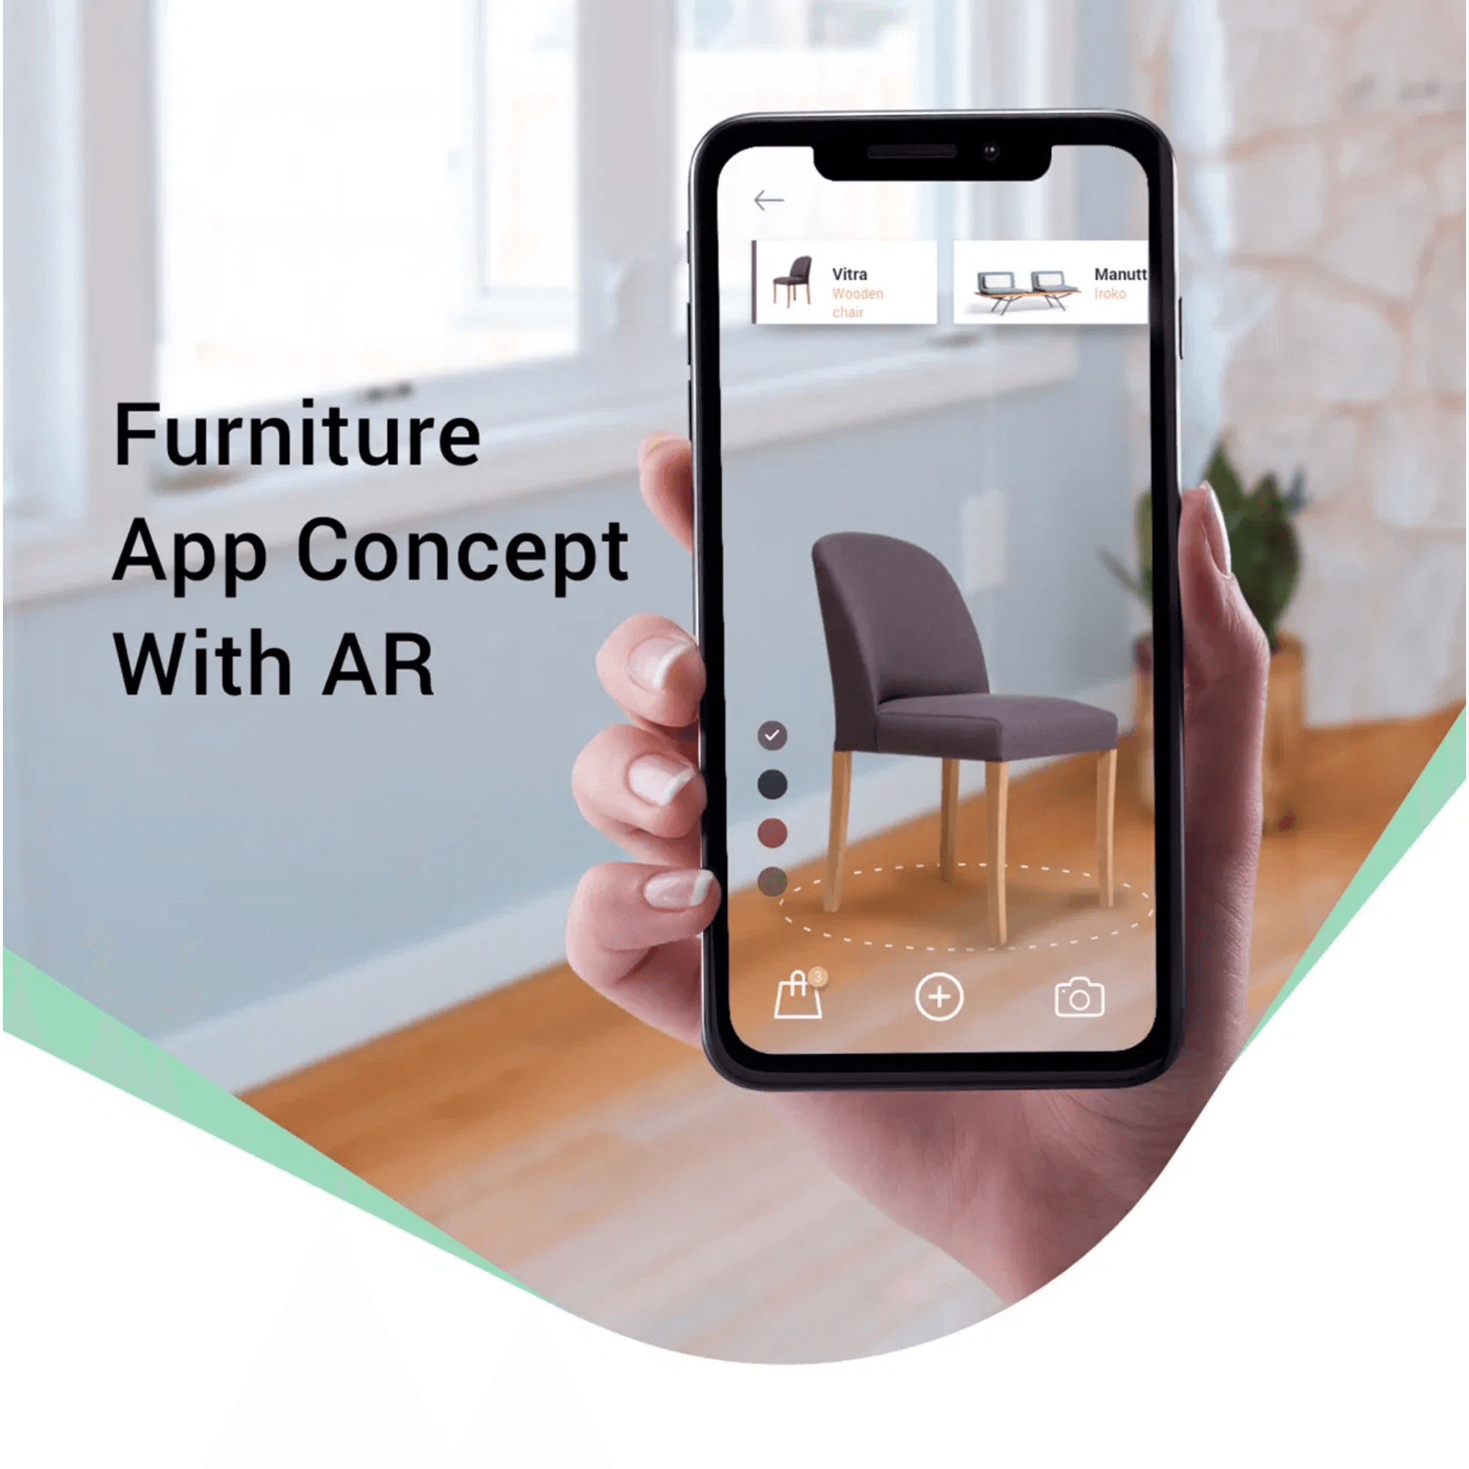
The Problem & Solution: Bridging the Gap in Interior Design
The Challenge
•
Inaccurate spatial understanding and measurement errors.
•
Uncertainty regarding furniture size compatibility and style fit.
•
Budget overruns due to trial-and-error purchasing.
The Solution
•
Intelligent AR Assistant:
A mobile platform using Computer Vision and Generative AI.
•
Seamless Visualization:
Bridges the gap between imagination and physical space.
•
Social Validation:
Combines AI precision with community-driven design wisdom.

Slide 5
Architecture（System Architecture）
Room Capture
& Reconstruction
Scene Understanding
User Input
AI Design Generation
AR Visualization & Interaction
Community Platform & Shopping
3D room modeling and spatial measurement
Layout generation based on space and user preferences
Design reuse, adaptation, and purchase support
Semantic labeling of walls, doors, walkable areas
Real-time preview and furniture manipulation
“This architecture supports an end-to-end workflow from room scanning to purchase decision.”

Slide 6

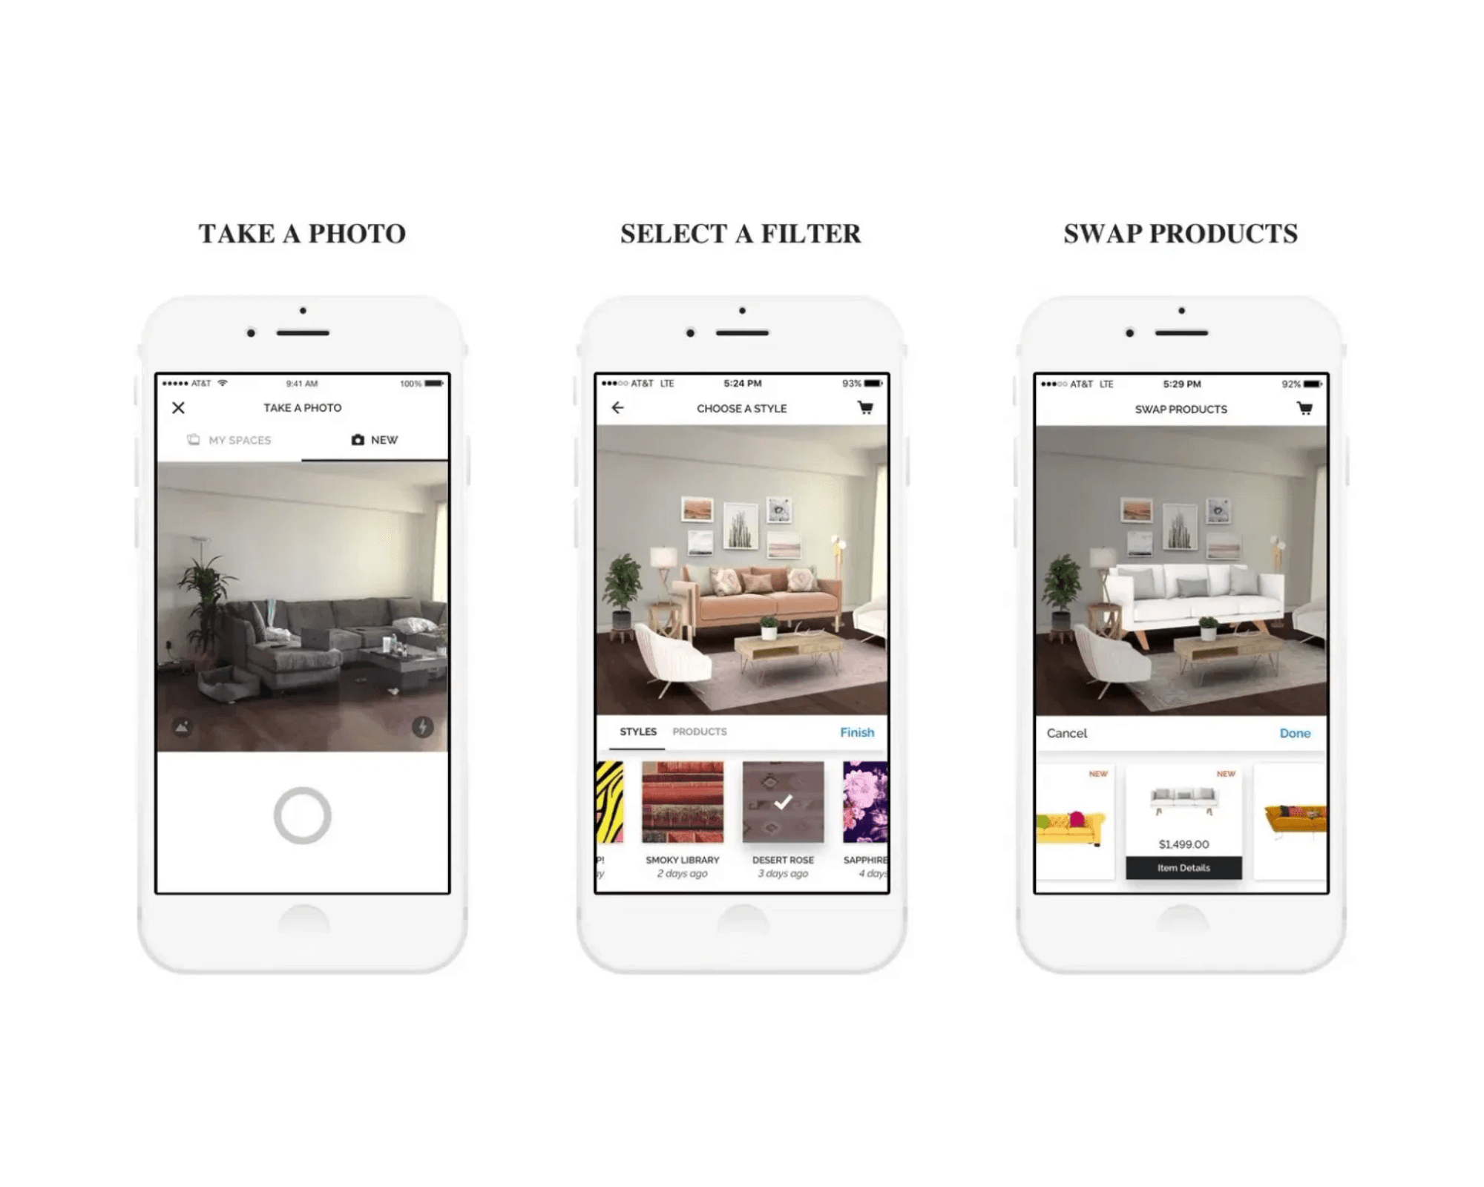
Core Features (Part 1): Room Scanning & AI Layout Generation
Room Capture & Reconstruction
Utilizes smartphone cameras to detect boundaries, measure dimensions, and create high-fidelity 3D spatial models of the user's environment.
Semantic Scene Understanding
Identifies existing furniture, walkable areas, and clearance zones (e.g., door swings) to ensure all generated designs are physically feasible.
AI-Assisted Generation
Processes natural language inputs (e.g., "Scandinavian style, budget RM3000") to produce multiple optimized layout proposals with conflict detection.

Slide 7
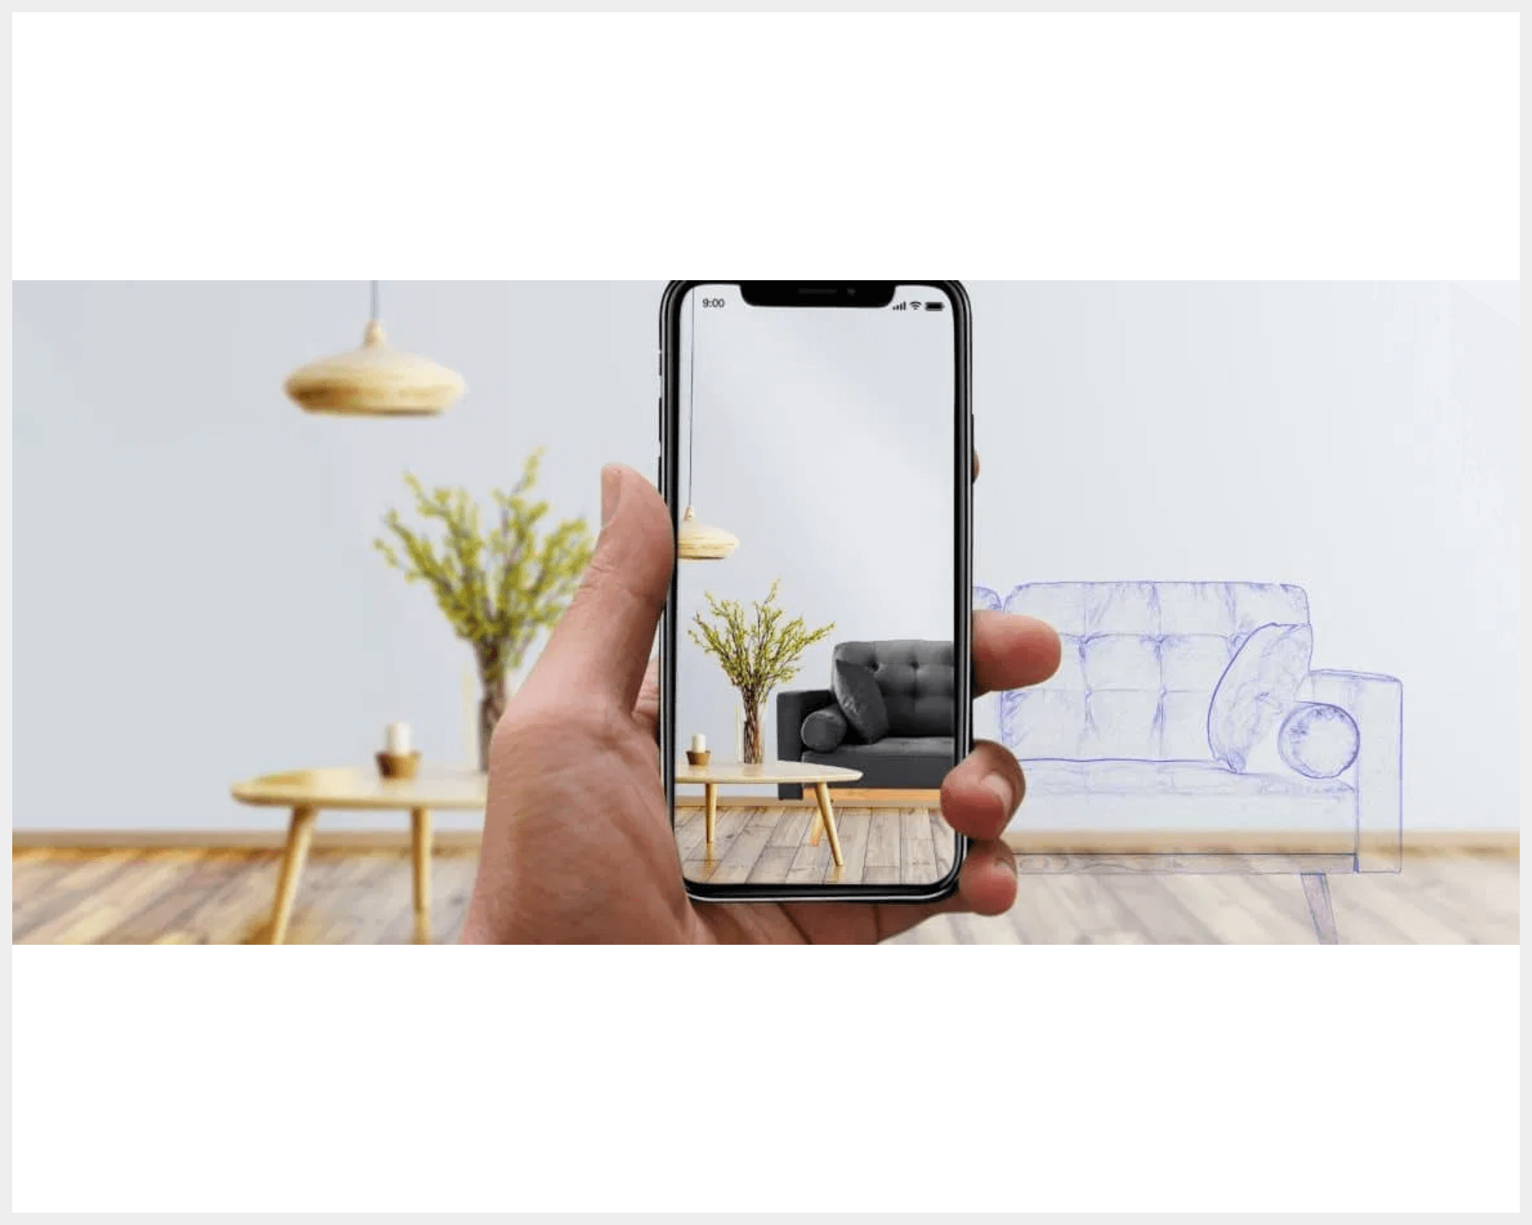
Core Features (Part 2): AR Visualization & Community Reuse
Immersive AR Interaction
•
Real-time Visualization:
Overlays virtual furniture with light estimation and occlusion handling for high realism.
•
Interactive Customization:
Drag, rotate, and snap furniture to walls/floors while maintaining spatial correctness.
Socially-Powered Design
•
Community Platform:
Browse and adapt designs from users with similar room layouts and furniture preferences.
•
Automatic Adaptation:
System scales and adjusts community designs to fit the user's specific room dimensions.

Slide 8
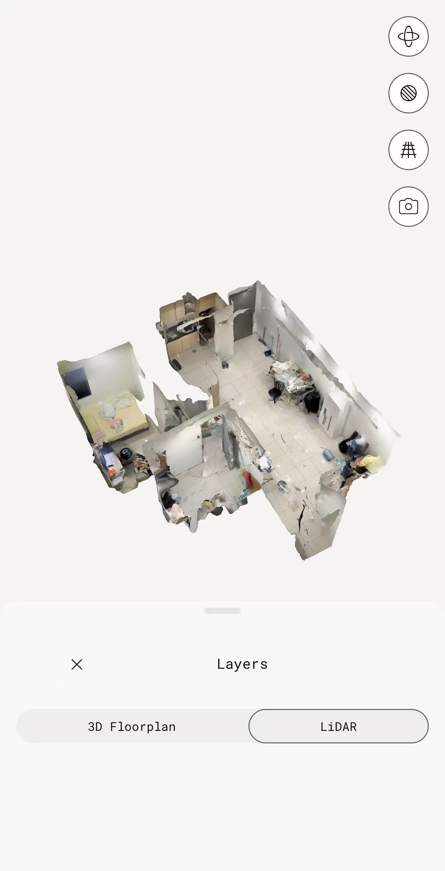
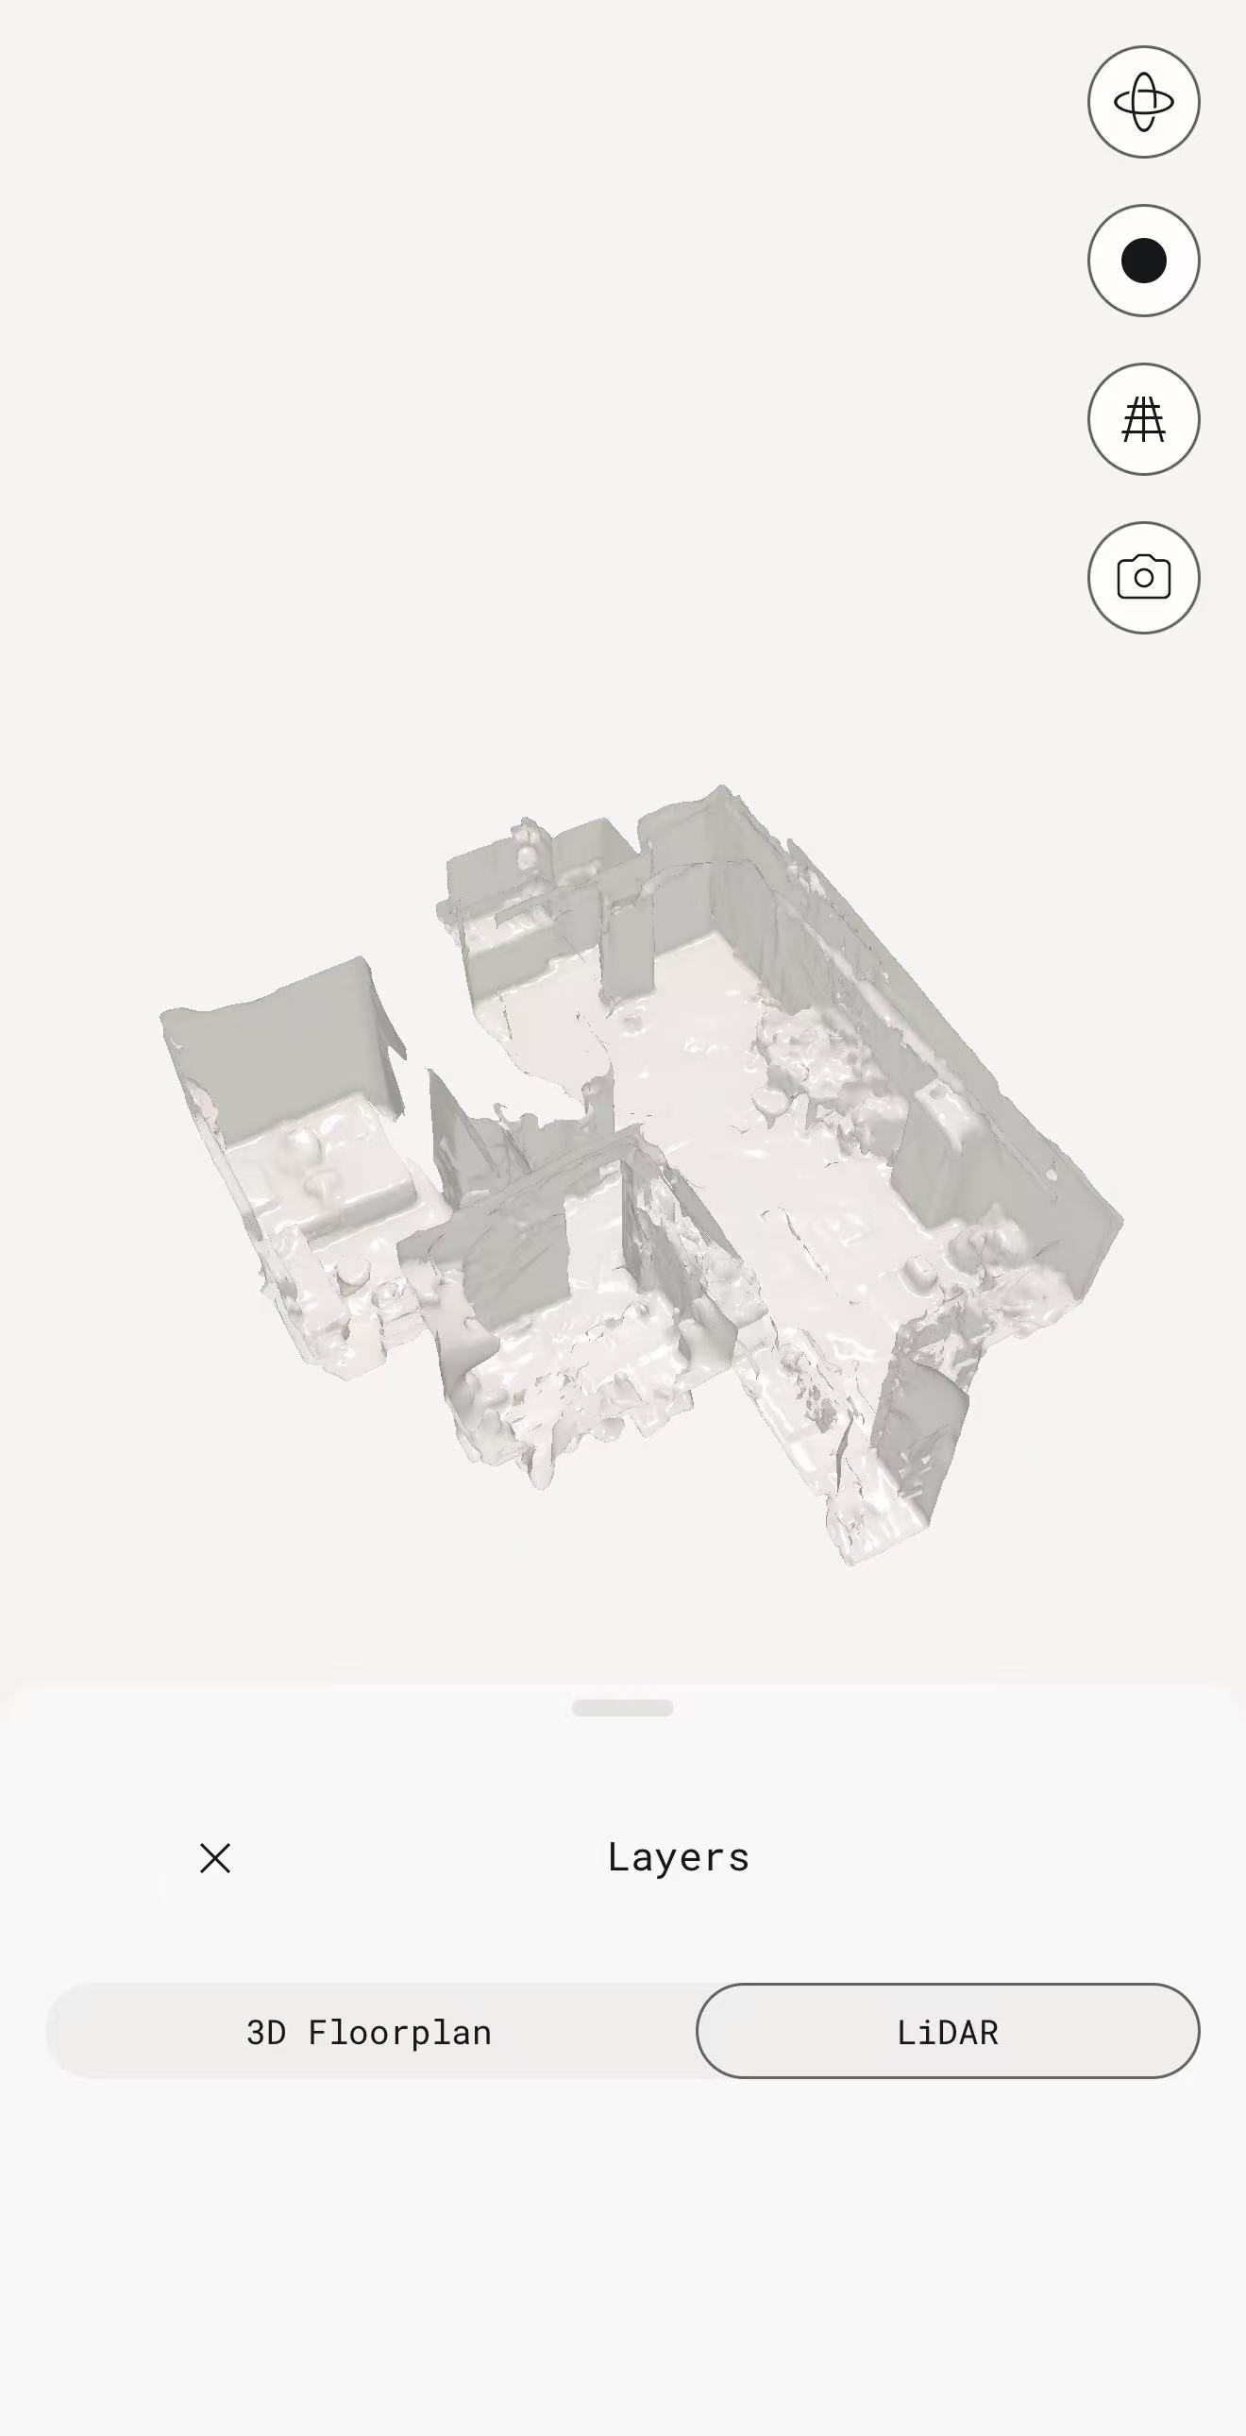
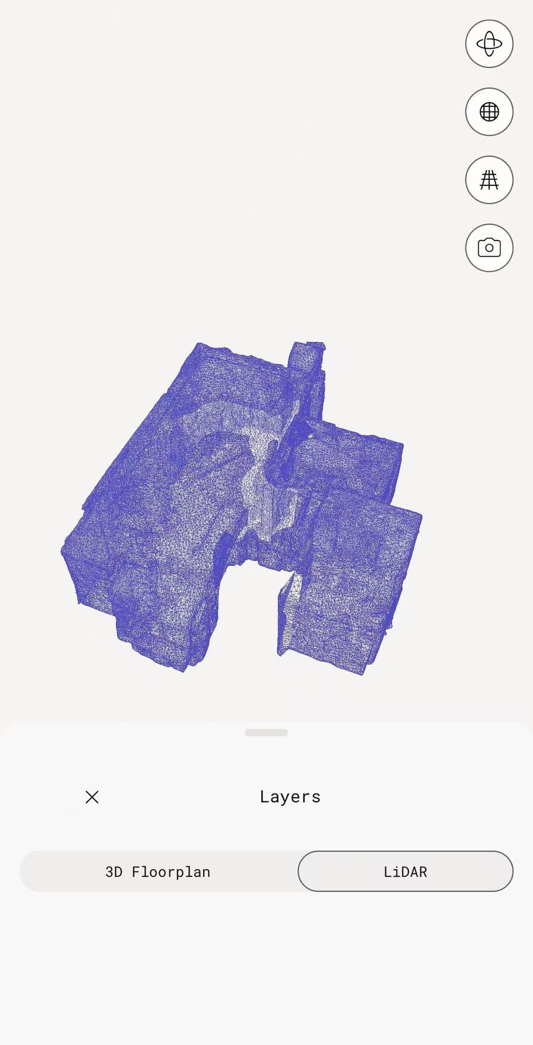
GUI Prototype
https://www.figma.com/make/Dk1Pk3F2yo4HSRjtWzaVfi/Mobile-GUI-Design-Report--Copy-?t=ZYRziibj5U8PkEbv-1

Slide 9
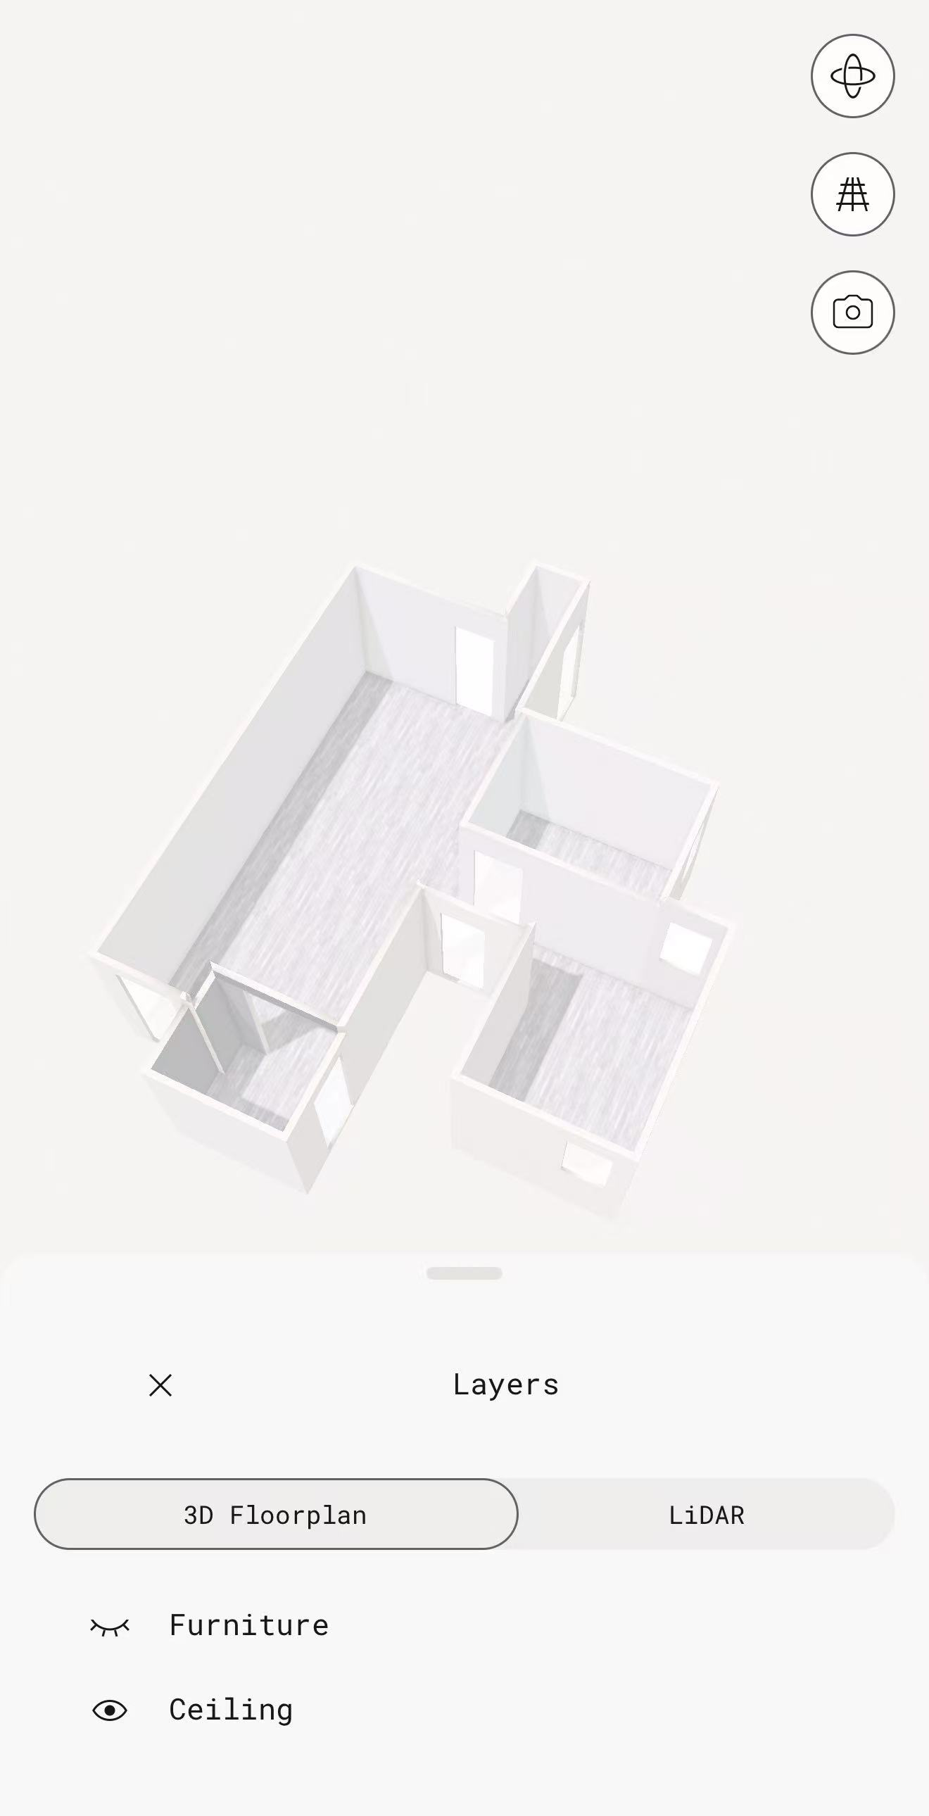
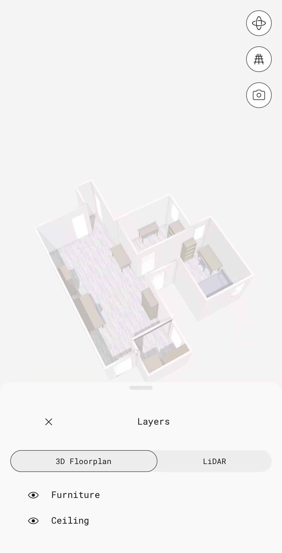
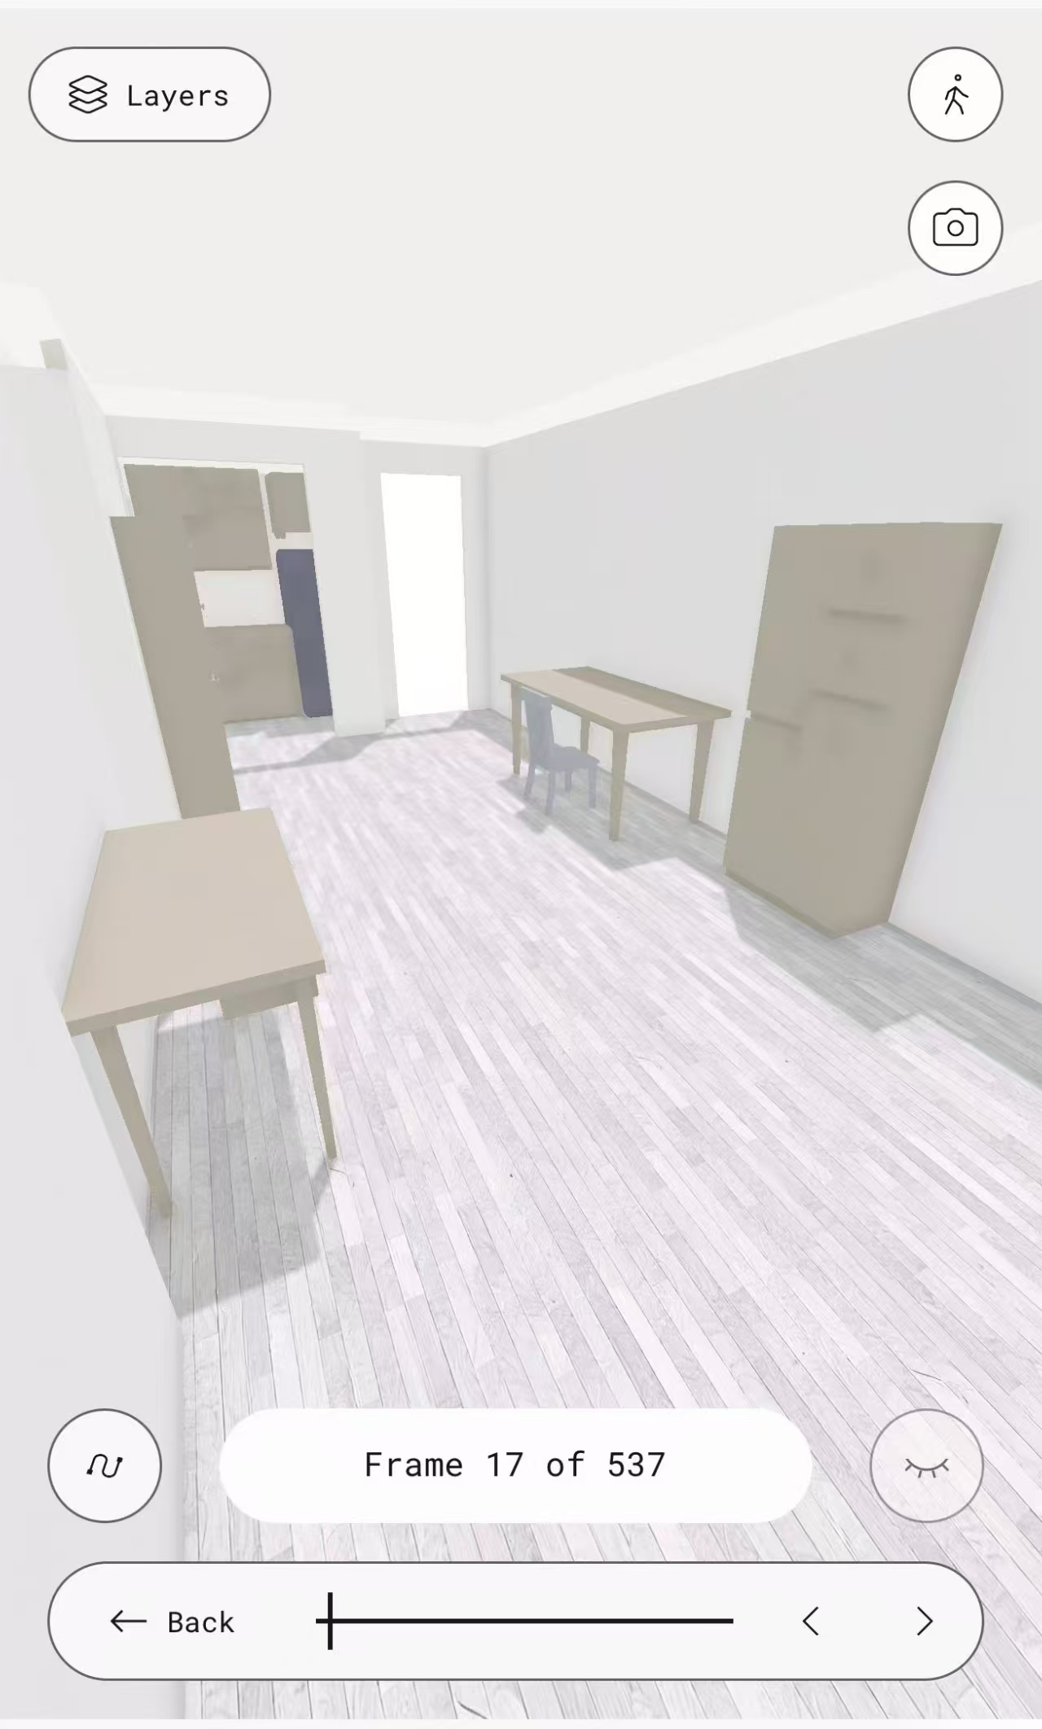
GUI Prototype
https://camel-secure-21405066.figma.site
Empty House
Furnished House
Furnished House
3D-Real time Preview

Slide 10
Justify & Compare
Aspect | Traditional Offline Shopping | Traditional AR Apps | Proposed 3D AR-based Solution
Measurement Accuracy | Manual measurement, prone to human error | Relies on estimated dimensions | Accurate 3D room reconstruction
Spatial Constraints | Often ignored until purchase | Limited awareness of real constraints | Explicit modeling of walkways and clearances
Visualization | Based on imagination or static display | 2D screen-based AR overlay | Real-time AR in reconstructed 3D space
Layout Feasibility | High risk of blocking paths or doors | Errors amplified by incorrect scale | Automatic detection of layout conflicts
Time & Effort | Time-consuming and physically demanding | Requires repeated trial-and-error | Efficient, guided design process
Decision Confidence | Low, relies on experience | Medium, but error-prone | High, supported by simulation and validation

Slide 11
Targeted Customers: Addressing Diverse User Needs
Renters Small-Apartment Residents
First-time Homeowners
Busy Working Professionals
•
Focus on size compatibility and space optimization.
•
Cohesive style guidance for complete room furnishing.
•
"One-click" design generation to save time and effort.
•
Flexible, non-permanent solutions for temporary living.
•
Confidence in large-scale investments and furniture sets.
•
Automated shopping lists for efficient purchasing.
Professional-grade visualization for empty spaces.
•
Explainable AI recommendations for quick decisions.
•
•
Avoid costly mistakes by previewing fit before purchase.
Empowering non-experts to create functional and aesthetically pleasing living spaces with intelligent, user-centric tools.

Slide 12

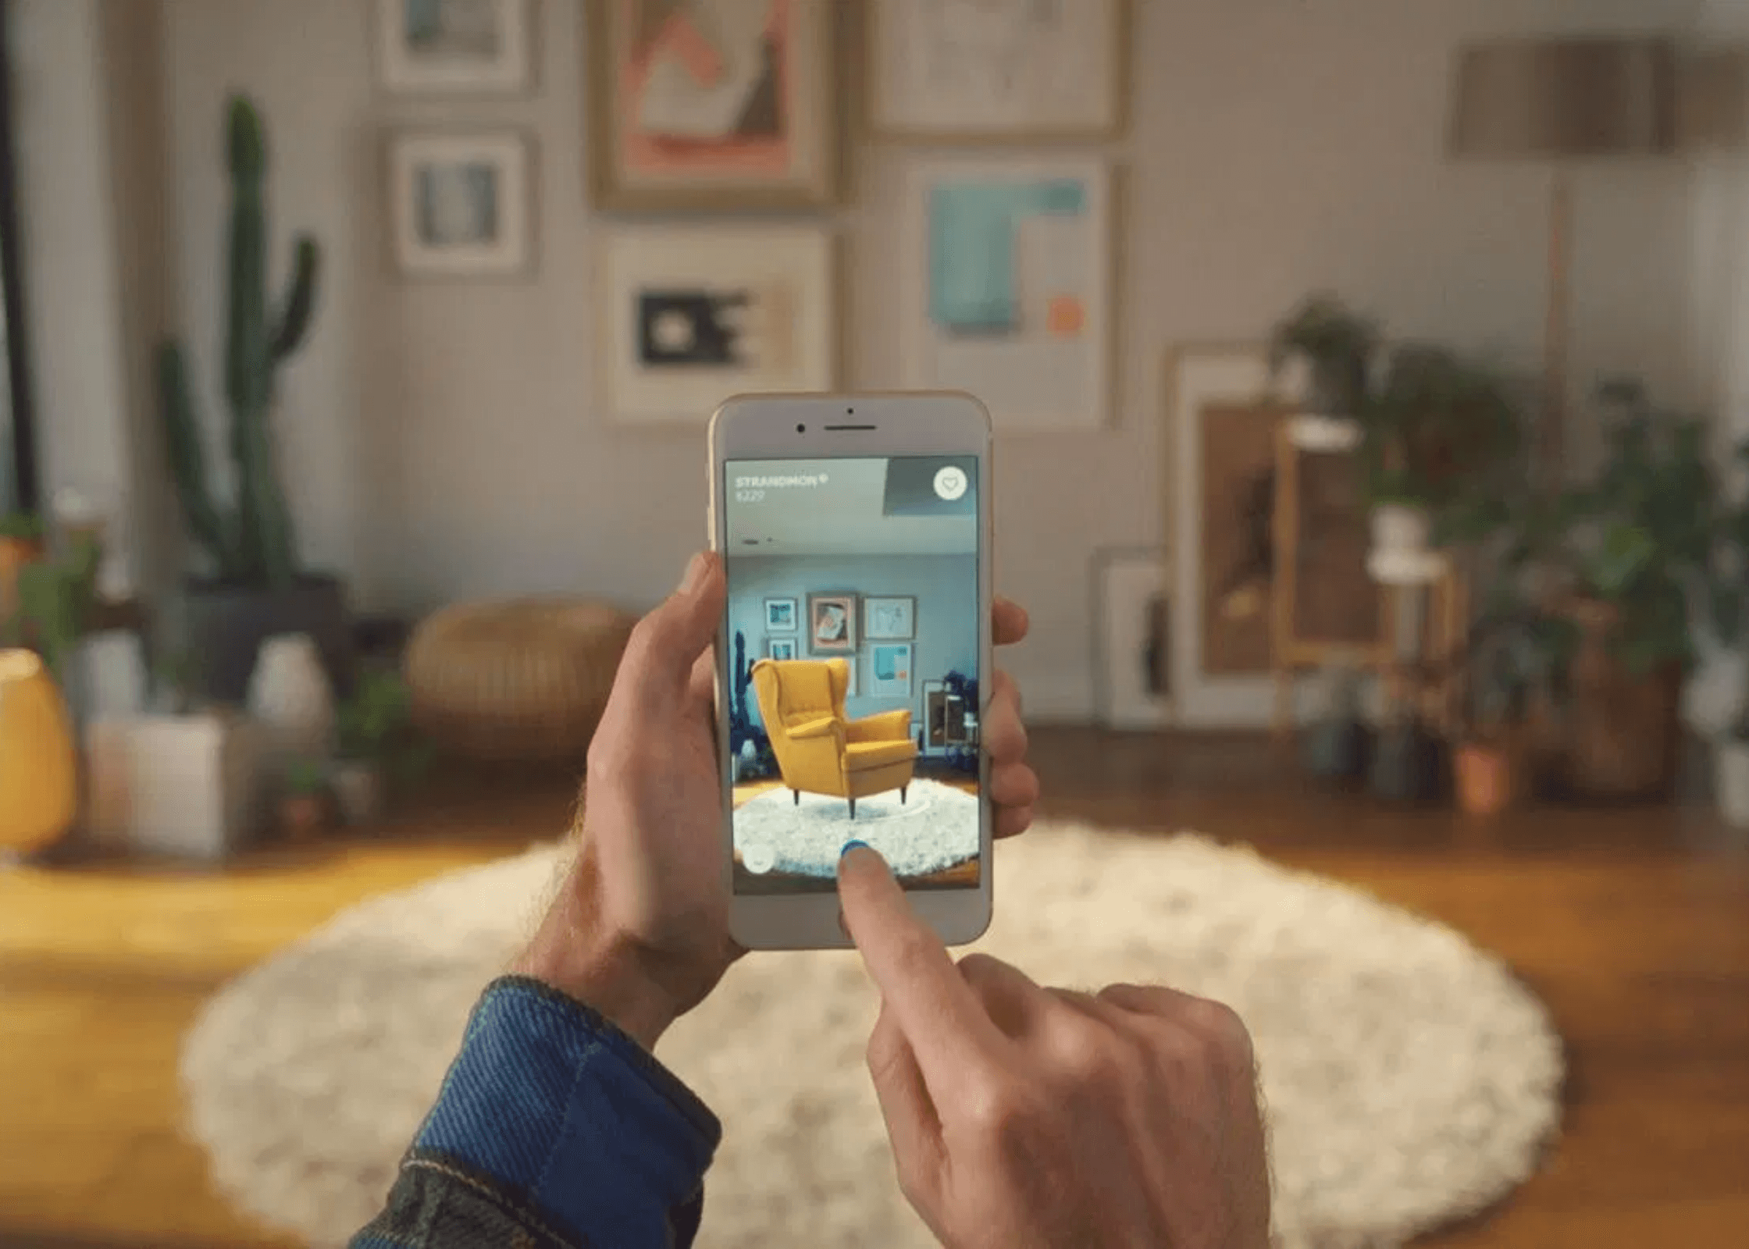
Promotion Strategies (Part 1): Digital & In-store Integration
Seamless App Integration
Embed the AR assistant directly into the existing IKEA mobile app to leverage the current global user base and reduce friction.
Omnichannel Promotion
Cross-promote via the IKEA website and online store to ensure a consistent digital journey from browsing to visualization.
In-store AR Demo Zones
Dedicated areas in physical stores where customers can experience the technology firsthand with staff guidance.
QR Code Accessibility
Instant access via QR codes on product tags, allowing customers to "try before they buy" in their own homes.

Slide 13

Promotion Strategies (Part 2): Community & Sustainability
Community Engagement
Eco-Consciousness
Community-Driven Growth
Sustainability Marketing
Highlight popular designs and reward top contributors with badges to foster an active, self-sustaining design ecosystem.
Promote eco-friendly options and "Sustainability Scores" for each design proposal to guide responsible consumption.
Social Sharing
Brand Alignment
Encourage users to share their AR-designed spaces on social media, creating organic brand advocacy and viral reach.
Position the service as a tool for responsible living, aligning with IKEA’s "People & Planet Positive" global strategy.
"Driving Engagement through Social Validation and Eco-Consciousness."

Slide 14

Social & Economic Impact: Creating Value for All
Social Impact
Economic Value
•
Democratizing Design
•
Increased Conversion
Lowers the barrier to professional interior design, empowering non-experts to create functional spaces.
Drives sales by providing high-fidelity previews that reduce purchase hesitation and decision friction.
•
Community Building
•
Operational Efficiency
Fosters collaboration and shared learning through the design reuse platform and social interaction.
Significantly reduces after-sales costs by minimizing product returns due to size or style mismatches.
•
Stress Reduction
•
Data-Driven Insights
Enhances user confidence and reduces the anxiety associated with complex furniture selection processes.
Generates valuable data on customer preferences and space usage to optimize future product development.
"Enhancing the customer journey while driving sustainable business growth through digital innovation."

Slide 15
Environmental Impact: Designing for a Greener Future
Minimized Returns
Eco-Friendly Guidance
Accurate measurements and AR previews significantly reduce the carbon footprint associated with product returns and reverse logistics.
The AI system prioritizes sustainable materials and energy-efficient layouts in its design recommendations.
Waste Reduction
Data-Driven Sustainability
Prevents the purchase of incompatible items that might otherwise end up as waste, promoting a more circular economy.
Provides insights into space usage patterns to optimize future product development for smaller, greener homes.
Aligning digital innovation with IKEA’s "People & Planet Positive" strategy to foster responsible consumption and sustainable living.

Slide 16

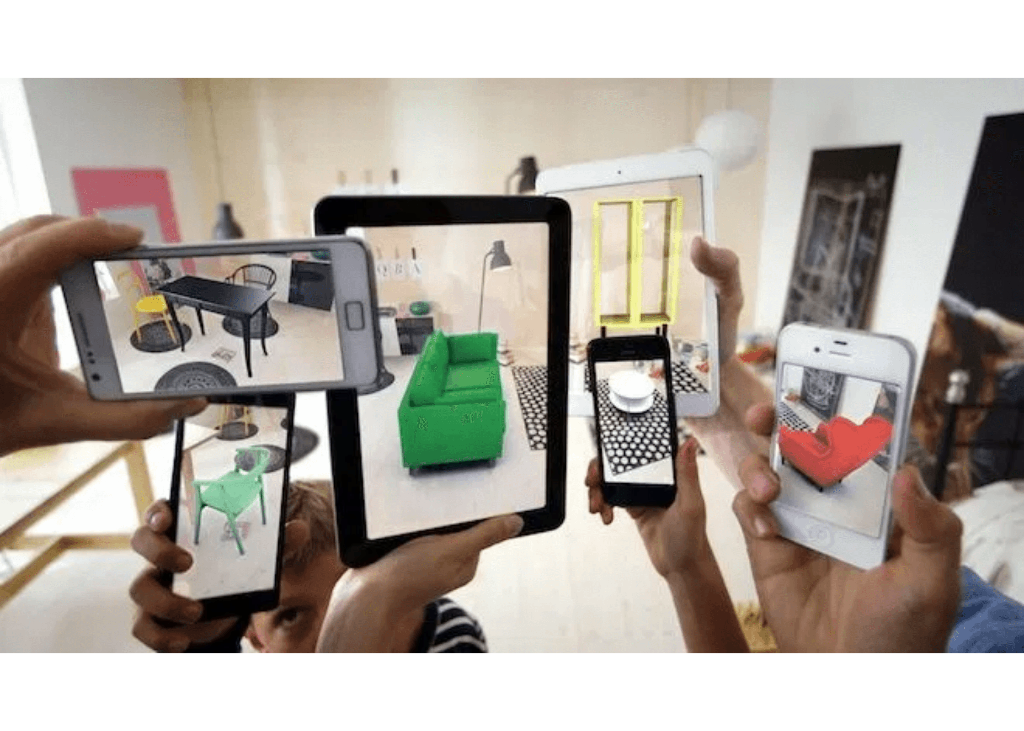
Conclusion: The Future of Intelligent Home Furnishing
A Comprehensive Ecosystem
The IKEA AR Assistant is more than a tool; it is a holistic ecosystem that combines cutting-edge technology with community wisdom to empower every user.
Future Outlook
Potential for deeper integration with smart home IoT and advanced generative design for fully autonomous, personalized interior planning.
"Innovation that balances form, function, and sustainability for the digital age, creating a better everyday life at home."

Slide 17
Reference
IKEA Systems B.V. (n.d.). Democratic design: The story of IKEA. Retrieved January 14, 2026, from https://about.ikea.com/en/about-us/democratic-design
Ingka Group. (n.d.). Ingka Group annual summary and sustainability report. Retrieved January 14, 2026, from https://www.ingka.com/about-us/annual-and-sustainability-summary-reports/
Bonetti, F., Warnaby, G., & Quinn, L. (2018). Augmented reality and virtual reality in physical and online retailing: A review, synthesis and research agenda. In Augmented Reality and Virtual Reality (pp. 119-132). Springer, Cham. https://doi.org/10.1007/978-3-319-64027-3_9
Heller, J., Chylinski, M., de Ruyter, K., Mahr, D., & Keeling, D. I. (2019). Let me imagine that for you: Transforming the retail encounter through augmented reality. Journal of Retailing, 95(2), 94-114. https://doi.org/10.1016/j.jretai.2019.03.005
Manzini, E. (2015). Design, when everybody designs: An introduction to design for social innovation. MIT Press.
Klinghoffer, T., Kushner, T., Wetzstein, G., & Raskar, R. (2024). PlatoNeRF: 3D reconstruction in Plato’s cave via single-view two-bounce LiDAR. Proceedings of the IEEE/CVF Conference on Computer Vision and Pattern Recognition (CVPR), 1234–12 https://openaccess.thecvf.com/content/CVPR2024/papers/Klinghoffer_PlatoNeRF_CVPR_2024_paper.pdf
Kolev, K., Tanskanen, P., Speciale, P., & Pollefeys, M. (2014). Turning mobile phones into 3D scanners. Proceedings of the IEEE Conference on Computer Vision and Pattern Recognition (CVPR), 3946–3953.
Para, W. A., Bhat, S. F., Guerrero, P., Wonka, P., & Niloy, M. (2021). Generative layout modeling using constraint graphs. Proceedings of the IEEE/CVF International Conference on Computer Vision (ICCV), 6690–6700.
Armeni, I., Sener, O., Zamir, A. R., Jiang, H., Brilakis, I., Fischer, M., & Savarese, S. (2016). 3D semantic parsing of large-scale indoor spaces. Proceedings of the IEEE Conference on Computer Vision and Pattern Recognition (CVPR), 1534–1543.
Thakkar, K. (2024). Generative AI based interior designing: A holistic approach. International Journal of Computer Applications, 186(12), 1-5.

Slide 18
Innovation that balances form, function, and sustainability.
Thanks
“ Bringing Imagination to Life.”

